Slide 1
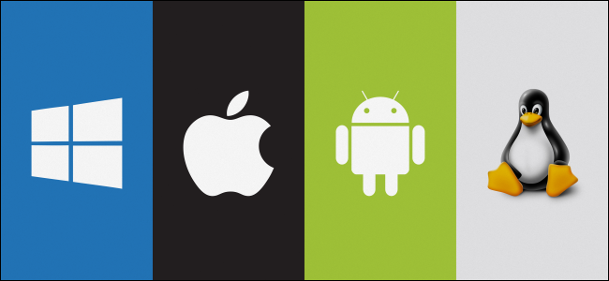
Operating System
Topic 6: Input & Output
Er. Nawaraj Bhandari

Slide 2
I/O System
One of the important jobs of an Operating System is to manage various I/O devices including mouse, keyboards, touch pad, disk drives, display adapters, USB devices, Bit-mapped screen, LED, Analog-to-digital converter, On/off switch, network connections, audio I/O, printers etc.

Slide 3
I/O System
An I/O system is required to take an application I/O request and send it to the physical device, then take whatever response comes back from the device and send it to the application. I/O devices can be divided into two categories −
Block devices − A block device is one with which the driver communicates by sending entire blocks of data. For example, Hard disks, USB cameras, Disk-On-Key etc.
Character devices − A character device is one with which the driver communicates by sending and receiving single characters (bytes, octets). For example, serial ports, parallel ports, sounds cards etc

Slide 4
Device Controllers
Device drivers are software modules that can be plugged into an OS to handle a particular device. Operating System takes help from device drivers to handle all I/O devices.
The Device Controller works like an interface between a device and a device driver. I/O units (Keyboard, mouse, printer, etc.) typically consist of a mechanical component and an electronic component where electronic component is called the device controller.

Slide 5
Device Controllers
There is always a device controller and a device driver for each device to communicate with the Operating Systems. A device controller may be able to handle multiple devices. As an interface its main task is to convert serial bit stream to block of bytes, perform error correction as necessary.
Any device connected to the computer is connected by a plug and socket, and the socket is connected to a device controller. Following is a model for connecting the CPU, memory, controllers, and I/O devices where CPU and device controllers all use a common bus for communication.

Slide 6
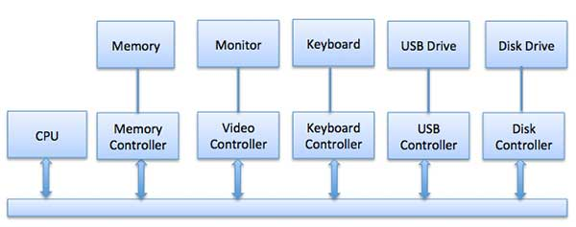
Device Controllers

Slide 7
Synchronous vs asynchronous I/O
Synchronous I/O − In this scheme CPU execution waits while I/O proceeds
Asynchronous I/O − I/O proceeds concurrently with CPU execution

Slide 8
Communication to I/O Devices
The CPU must have a way to pass information to and from an I/O device. There are three approaches available to communicate with the CPU and Device.
Special Instruction I/O
Memory-mapped I/O
Direct memory access (DMA)

Slide 9
Special Instruction I/O
This uses CPU instructions that are specifically made for controlling I/O devices. These instructions typically allow data to be sent to an I/O device or read from an I/O device.

Slide 10
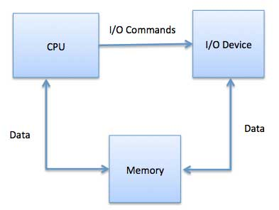
Memory-mapped I/O
When using memory-mapped I/O, the same address space is shared by memory and I/O devices. The device is connected directly to certain main memory locations so that I/O device can transfer block of data to/from memory without going through CPU.

Slide 11
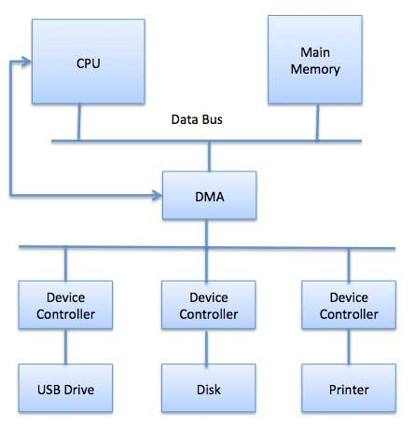
Direct Memory Access (DMA)

Slide 12
Direct Memory Access (DMA)
Slow devices like keyboards will generate an interrupt to the main CPU after each byte is transferred.
If a fast device such as a disk generated an interrupt for each byte, the operating system would spend most of its time handling these interrupts. So a typical computer uses direct memory access (DMA) hardware to reduce this overhead.

Slide 13
Direct Memory Access (DMA)
Direct Memory Access (DMA) means CPU grants I/O module authority to read from or write to memory without involvement. DMA module itself controls exchange of data between main memory and the I/O device. CPU is only involved at the beginning and end of the transfer and interrupted only after entire block has been transferred.
Direct Memory Access needs a special hardware called DMA controller (DMAC) that manages the data transfers and arbitrates access to the system bus. The controllers are programmed with source and destination pointers (where to read/write the data), counters to track the number of transferred bytes, and settings, which includes I/O and memory types, interrupts and states for the CPU cycles.

Slide 14
Goals of the I/O Software
A key concept in the design of I/O software is known as device independence. It means that I/O devices should be accessible to programs without specifying the device in advance.
Uniform Naming, simply be a string or an integer and not depend on the device in any way. In UNIX, all disks can be integrated in the file-system hierarchy in arbitrary ways so the user need not be aware of which name corresponds to which device.
Error Handling: If the controller discovers a read error, it should try to correct the error itself if it can. If it cannot, then the device driver should handle it, perhaps by just trying to read the block again. In many cases, error recovery can be done transparently at a low level without the upper levels even knowing about the error.

Slide 15
Goals of the I/O Software
Synchronous (blocking) and Asynchronous (interrupt-driven) transfers: Most physical I/O is asynchronous, however, some very high-performance applications need to control all the details of the I/O, so some operating systems make asynchronous I/O available to them.
Buffering: Often data that come off a device cannot be stored directly in their final destination.
Sharable and Dedicated devices: Some I/O devices, such as disks, can be used by many users at the same time. No problems are caused by multiple users having open files on the same disk at the same time. Other devices, such as printers, have to be dedicated to a single user until that user is finished. Then another user can have the printer. Introducing dedicated (unshared) devices also introduces a variety of problems, such as deadlocks. Again, the operating system must be able to handle both shared and dedicated devices in a way that avoids problems.

Slide 16

THANK YOU !
“

